Slide 1

COVID-19 MONITOR
Europe and central Asia
[Unless otherwise specified, data is as of May 22nd]

Slide 2
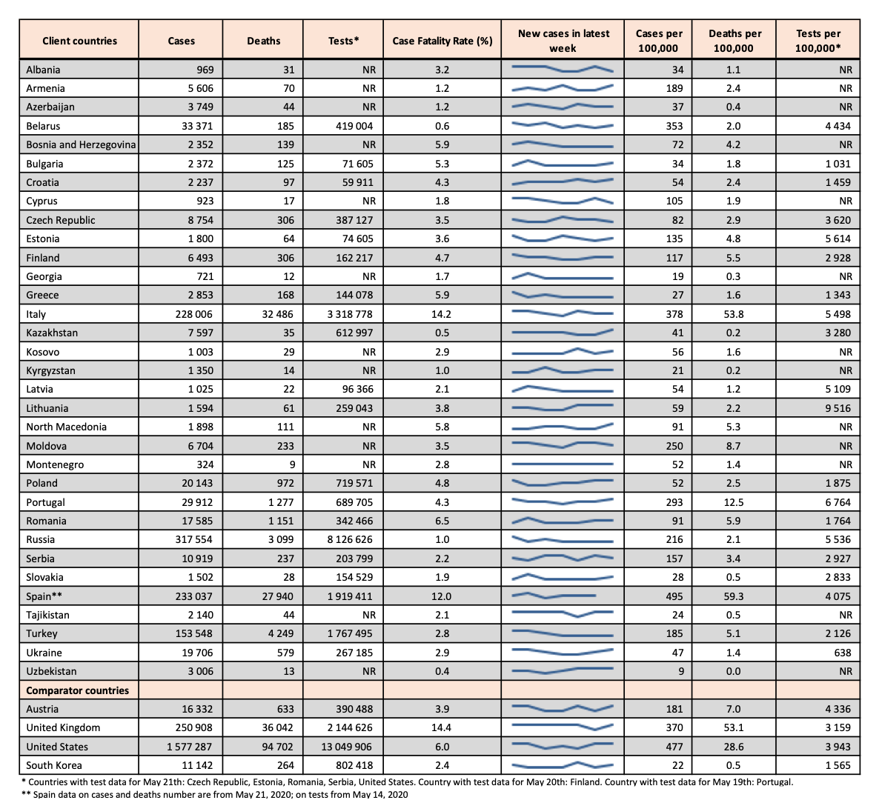
Cases, case fatality rates, and testing
•Cases per 100,000 population range from 9 in Uzbekistan to 378 in Italy and 495 in Spain.
•Case fatality rates are below 5% in most client countries, with higher rates in Italy (14.2%) and Spain (12%).
•A significant number of countries do not report accurate official data on testing (NR).
•Units for testing are also not consistent across countries (person vs. tests).
•Variation in testing rates (per 100,000) from 638 in Ukraine to 9,516 in Lithuania.
•Testing rates may partially explain variation in reported cases.
•To propose a data source for a country missing testing data, kindly fill this link.

Slide 3
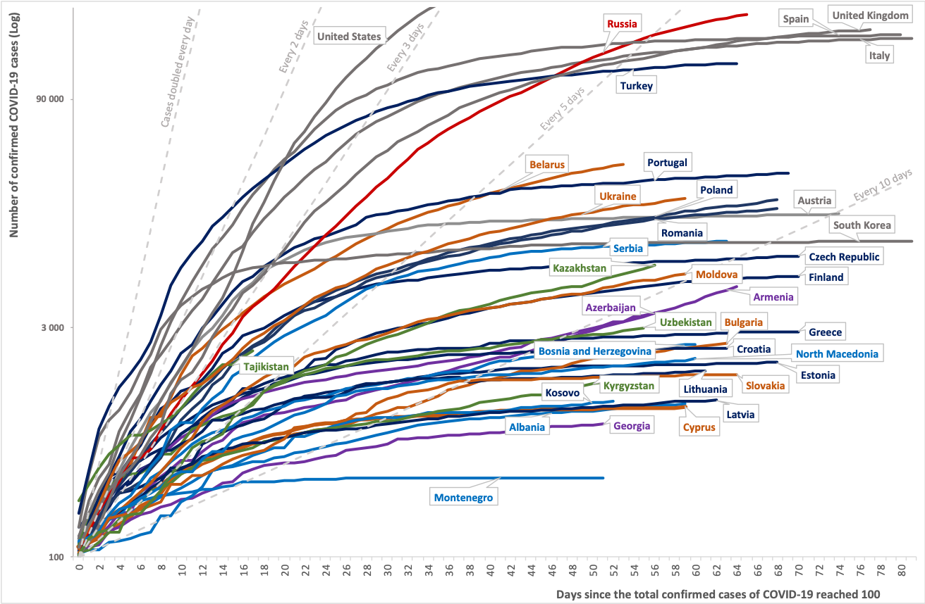
Cumulative case count in client and comparator countries
•This chart plots trajectories in reported total cases for client countries and four comparators, since reporting the 100th case: Austria, United States, United Kingdom, and South Korea.
•Growth in cases in Russia is slowing and doubling time remains above 5 days.
•However, cases in Armenia and Kazakhstan appear to be rising, at an increasing rate.
•The doubling rate for cases for other countries indicates a slowdown in spread of the virus.
Notes:
Restricted to countries with ≥ 100 cases.

Slide 4
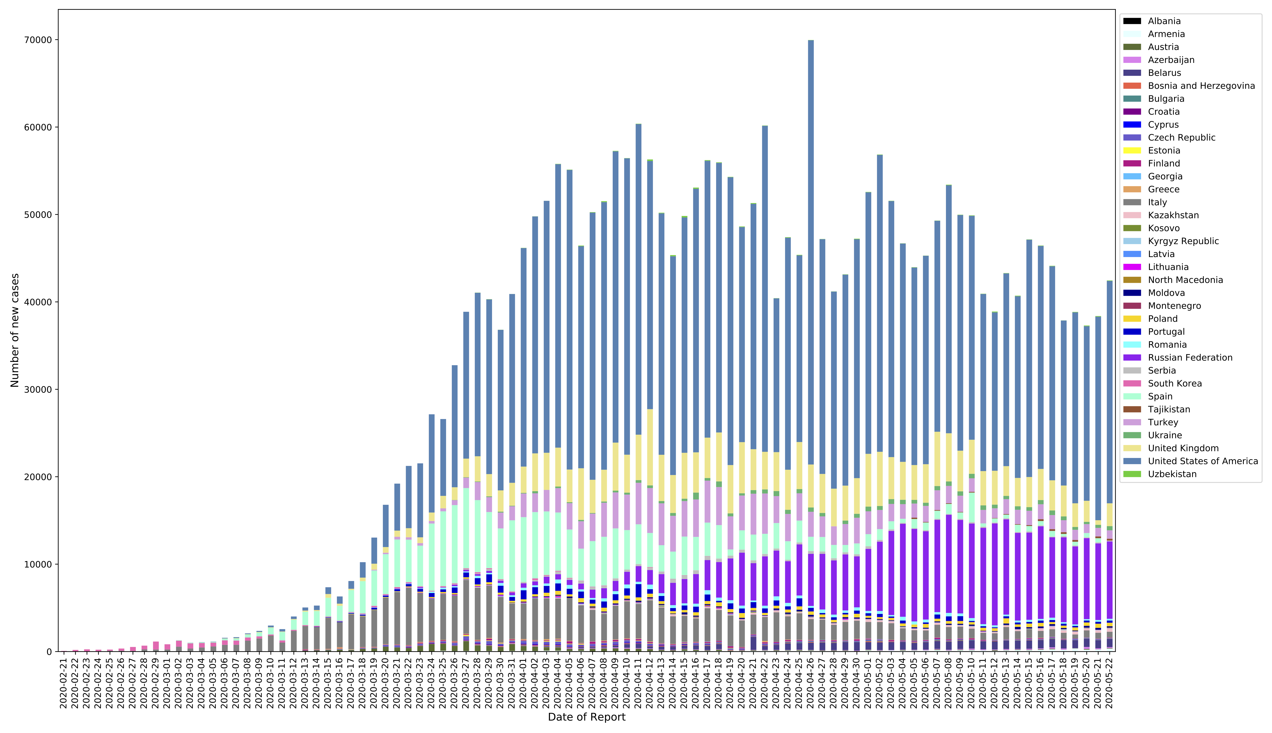
Number of new cases reported daily
​​This chart plots case incidence between February 21st and May 22th among client countries.
The chart includes data for four comparator countries: Austria, United States, United Kingdom, and South Korea.
Notable is the decrease in new cases in Spain in absolute terms.
Case incidence is decreasing in Russia, Italy, Spain and Turkey.

Slide 5
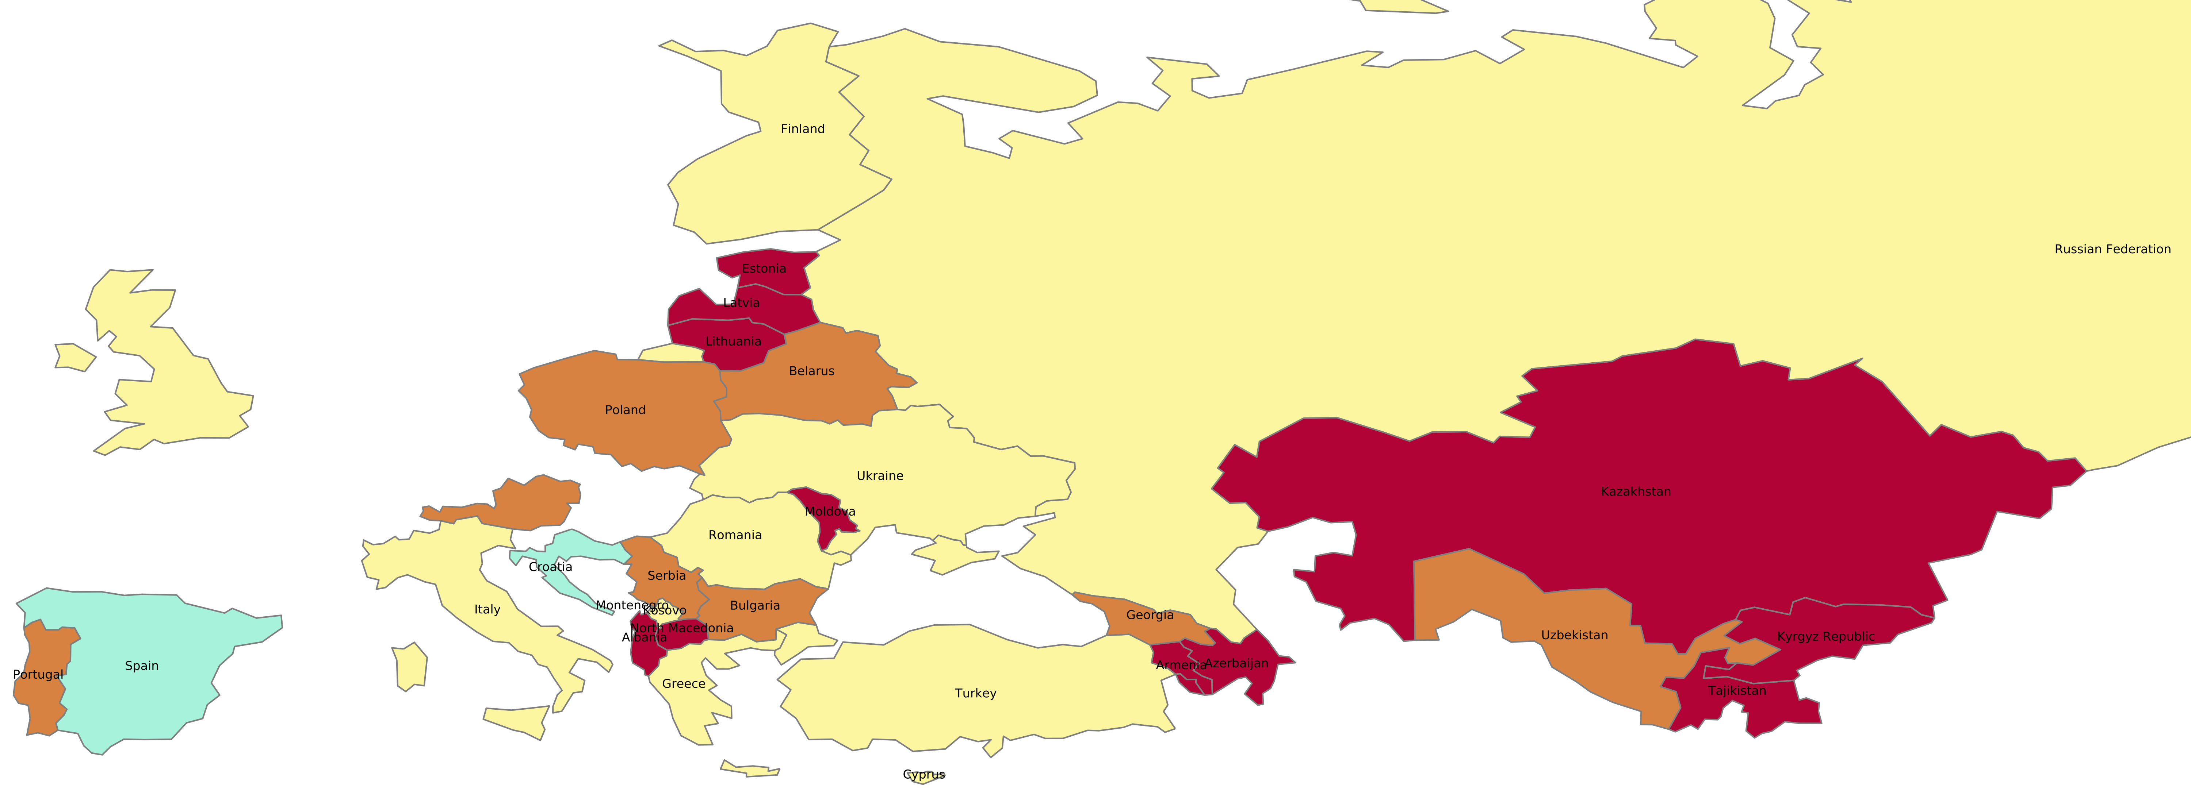
Most recent two-week span: percent change in new cases per 100,000 population
This map plots the change in incidence of cases (in %) between the current week (May 16th to 22th) and the preceding week (May 9nd to 15th).
Case incidence is accelerating in a few countries, with dramatic increases in Kazakhstan (130%) and Tajikistan (177%).
Notably, Italy has seen a 32% slowing in new cases.
These increases should be interpreted in light of the absolute case count.
Color | Key | Countries
 | -110 to – 50: Dramatic slowing of spread | Croatia, Spain.
 | -50 to -5: Spread slowing | Italy, Kosovo, Finland, Romania, Turkey, Russian Federation, Cyprus, Greece, Ukraine.
 | -5 to 5: Spread contained | Poland, Portugal, Belarus, Bulgaria, Georgia, Serbia, Uzbekistan.
 | 5 to 100: Spread accelerating | Lithuania, Estonia, North Macedonia, Kyrgyz Republic, Latvia, Moldova, Albania, Azerbaijan, Armenia, Kazakhstan, Tajikistan etc.
Note: Boundaries were cleared by the World Bank Map Design Cartography and Map Clearance Teams.

Slide 6
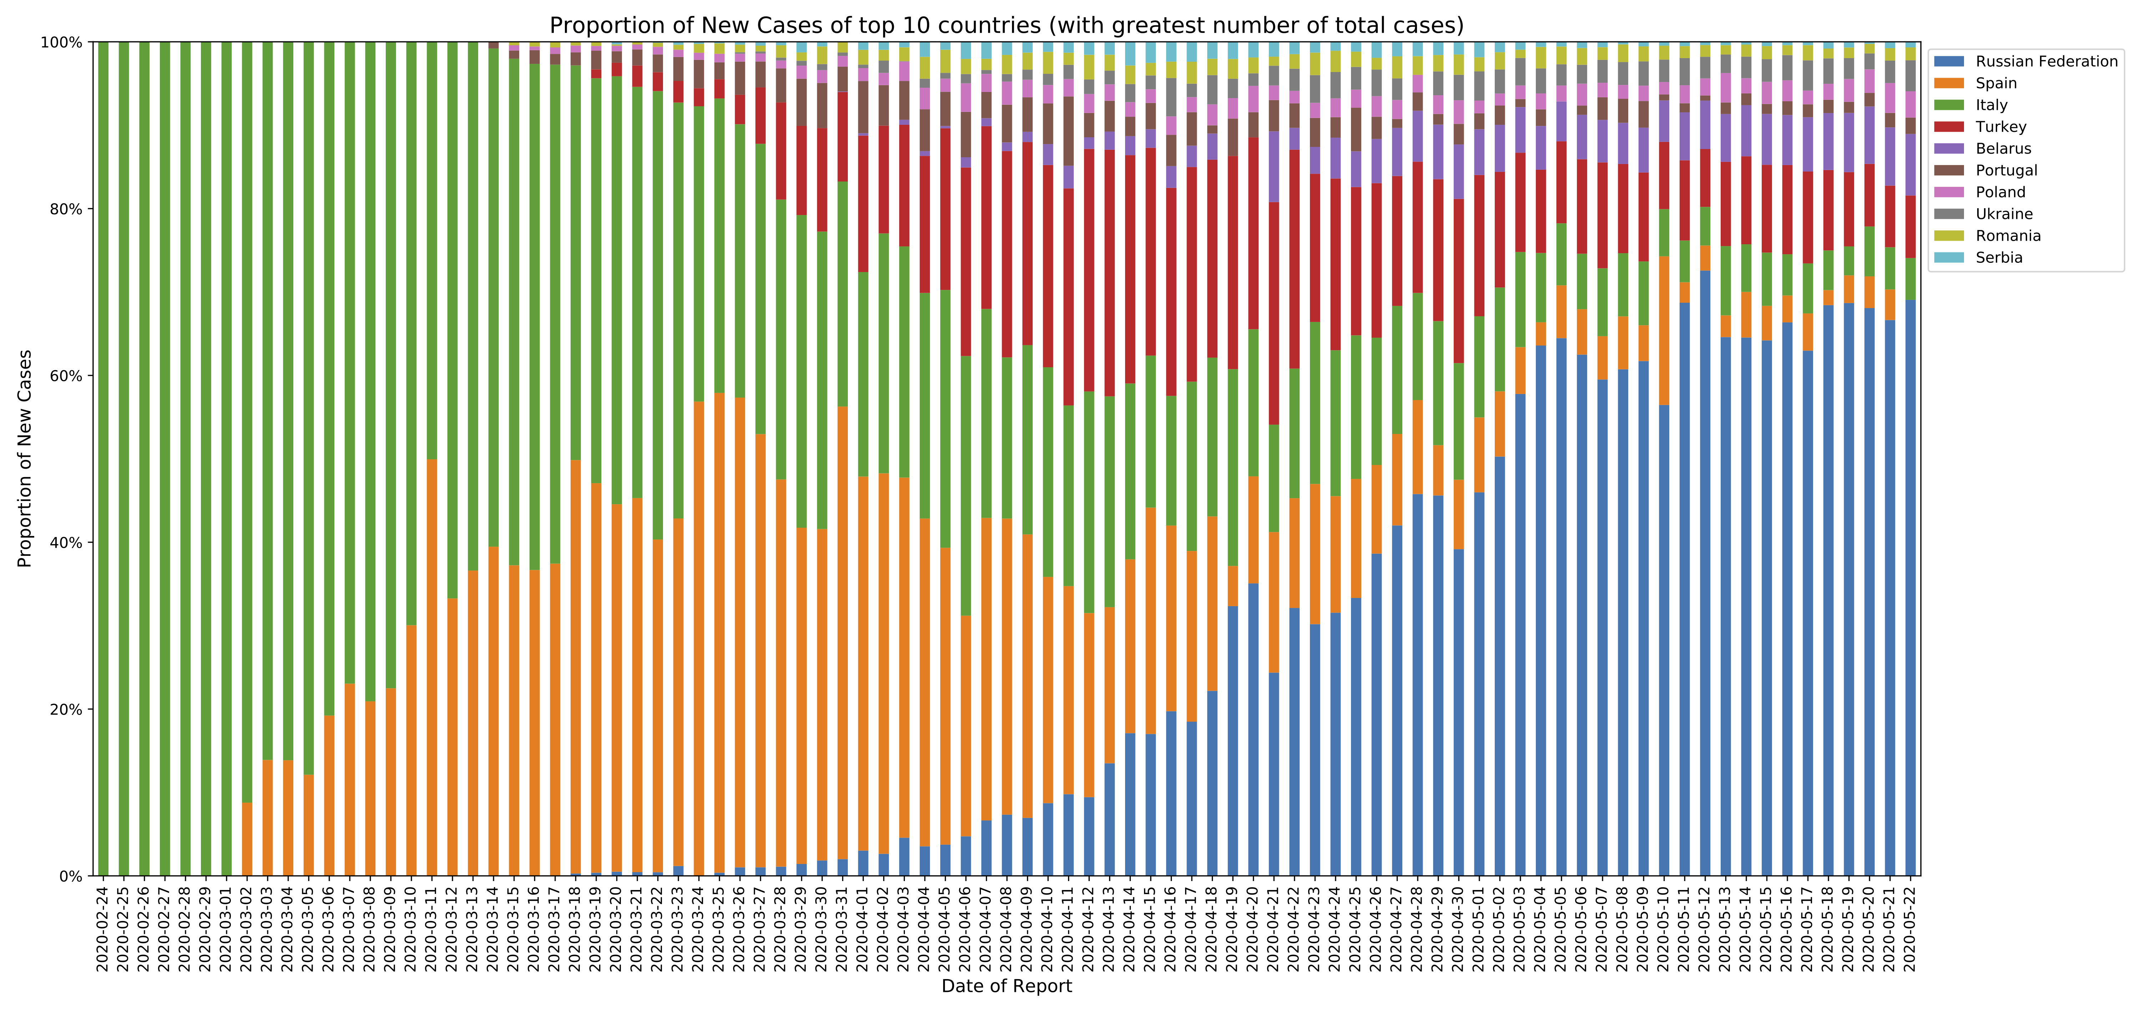
Proportion of new cases in 10 client countries with the highest total number of cases
​
The proportion of new cases in the 10 countries with a high case prevalence, is decreasing.
The overall contribution of Russia to case incidence remains relatively high.

Slide 7
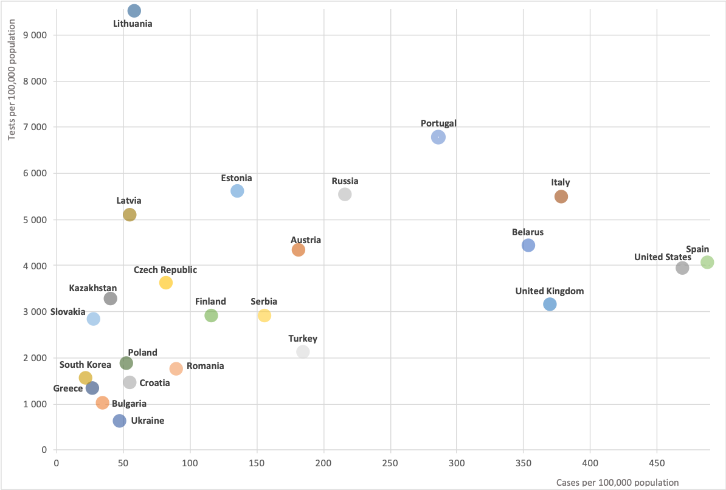
Total cases and tests per 100,000 population
Given the potential for undertesting to limit reported cases, this chart plots total cases and test per 100,000 population for client countries and four comparators: Austria, United States, United Kingdom, and South Korea.
The cluster of countries in the bottom left-hand corner are relatively low-testers: Ukraine, Bulgaria, Croatia, Greece, Poland, and Romania.
Countries with data for May 21st: Czech Republic, Estonia, Romania, Serbia, United States. Country with data for May 20th: Finland.
Country with data for May 19th: Portugal. Country with data for May 14th: Spain.

Slide 8
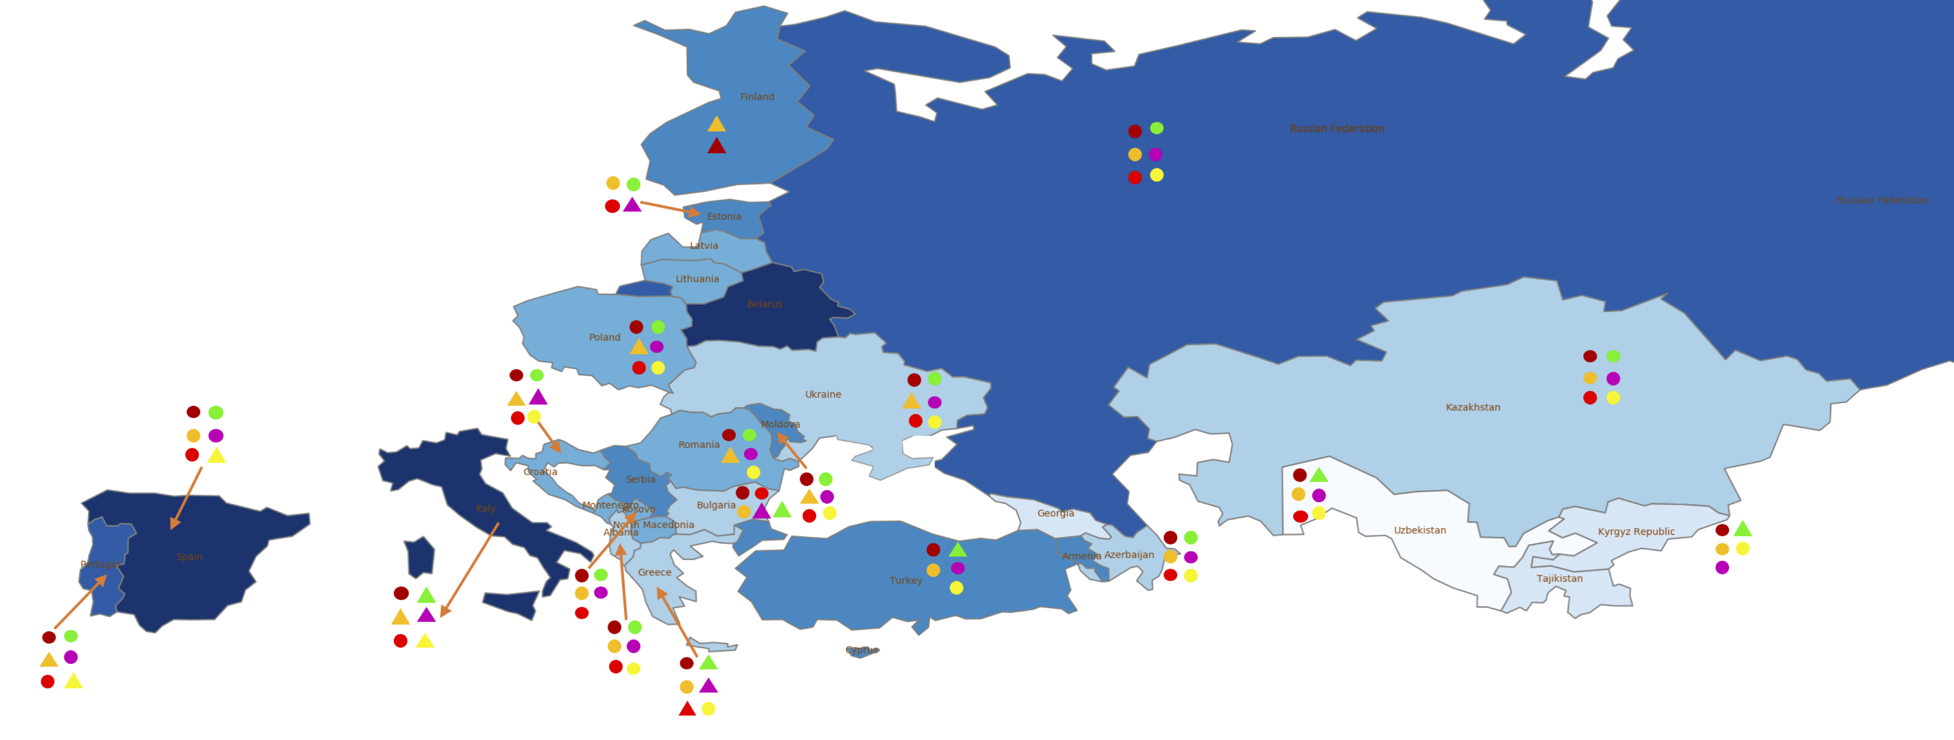
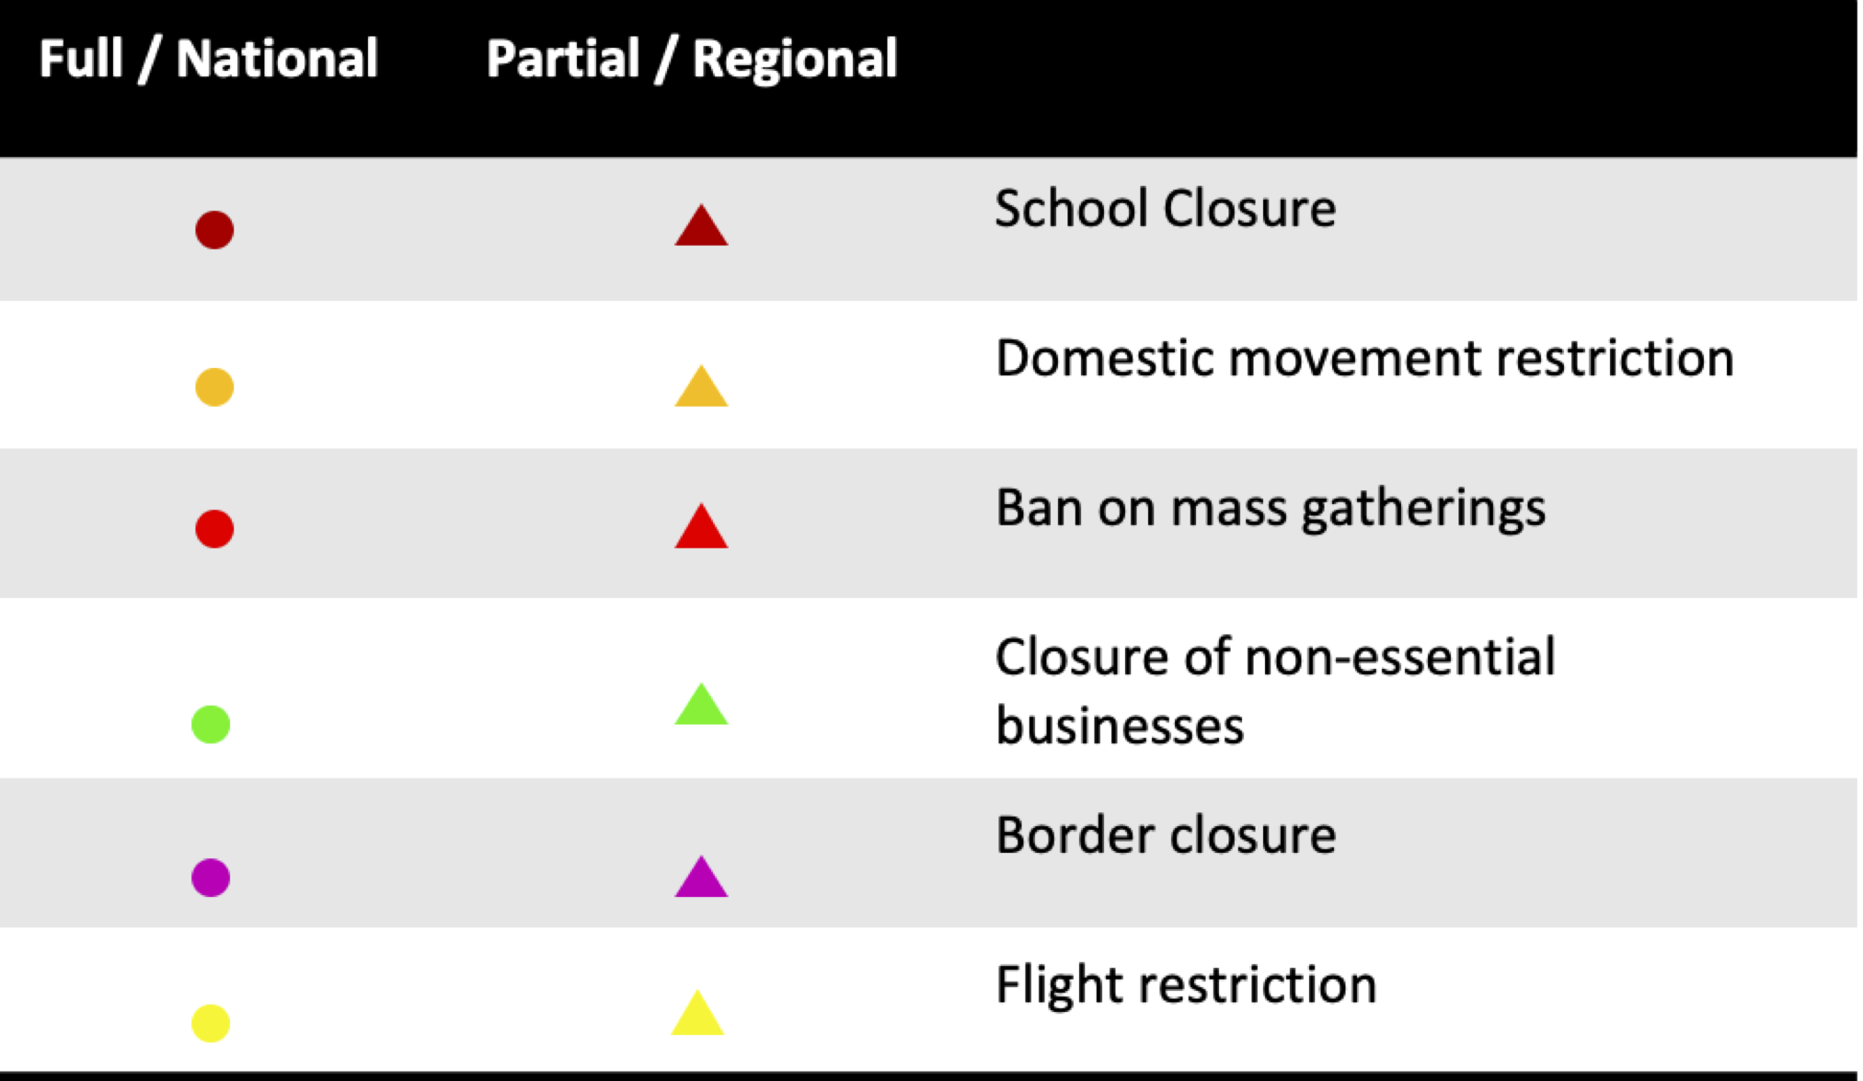
Public health and social measures implemented in the region
Color | Total cases/100,000 | Countries
 | 0-10 | Uzbekistan.
 | 10-25 | Georgia, Kyrgyz Republic, Tajikistan.
 | 25-50 | Greece, Albania, Azerbaijan, Kazakhstan, Ukraine.
 | 50-100 | Kosovo, Montenegro, Romania, North Macedonia.
 | 100-200 | Cyprus, Finland, Serbia, Turkey, Moldova, Armenia.
 | 200-300 | Russian Federation, Portugal.
 | 300+ | Belarus, Italy, Spain.
Italy is easing up its restrictions the most, followed by Greece and Bulgaria.
​
Russian Federation, ​Kazakhstan, Azerbaijan, Albania have maximum restrictions.
Countries like Macedonia, Belarus, Lithuania, Georgia, and Latvia have missing data on their policy responses.
Note: Boundaries were cleared by the World Bank Map Design Cartography and Map Clearance Teams.

Slide 9
Countries and data sources
Albania | Georgia | Poland
Armenia | Greece | Portugal
Azerbaijan | Italy | Romania
Belarus | Kazakhstan | Russian Federation
Bulgaria | Kosovo | Serbia
Bosnia and Herzegovina | Kyrgyz Republic | Slovak Republic
Croatia | Latvia | Spain
Cyprus | Lithuania | Tajikistan
Czech Republic | Moldova | Turkey
Estonia | Montenegro | Turkmenistan (no cases)
Finland | North Macedonia | Ukraine
 |  | Uzbekistan
The monitor focuses on client countries in Europe and Central Asia with any lending or non-lending operation, and with available data, as in the Table.
In selected slides, comparator countries are presented, which are significant for their disease trajectories: Austria, United States, United Kingdom, and South Korea.
Data from:
Cases, testing, and deaths: https://ourworldindata.org/coronavirus.
Policy responses: https://ourworldindata.org/policy-responses-covid
Population: provided by task teams or imputed from “our world in data”.

